Slide 1
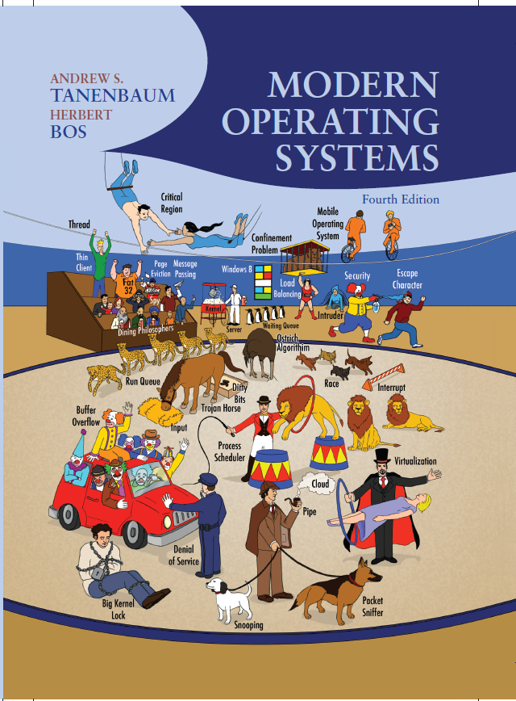
Modern Operating Systems
Fourth Edition
Chapter 2
Processes and Threads
Copyright © 2014 Pearson Education, Inc. All Rights Reserved
Notes:
If this PowerPoint presentation contains mathematical equations, you may need to check that your computer has the following installed:
1) MathType Plugin
2) Math Player (free versions available)
3) NVDA Reader (free versions available)

Slide 2
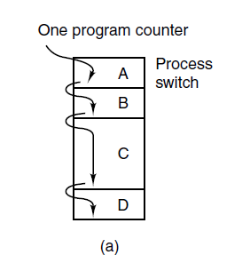
The Process Model (1 of 3)
Figure 2-1. (a) Multiprogramming of four programs.

Slide 3
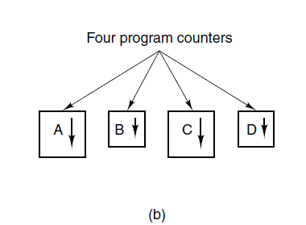
The Process Model (2 of 3)
Figure 2-1. (b) Conceptual model of four independent, sequential processes.

Slide 4
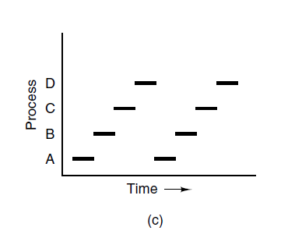
The Process Model (3 of 3)
Figure 2-1. (c) Only one program is active at once.

Slide 5
Process Creation
Four principal events that cause processes to be created:
System initialization.
Execution of a process creation system call by a running process.
A user request to create a new process.
Initiation of a batch job.

Slide 6
Process Termination
Typical conditions which terminate a process:
Normal exit (voluntary).
Error exit (voluntary).
Fatal error (involuntary).
Killed by another process (involuntary).

Slide 7
Process States (1 of 3)
Three states a process may be in:
Running (actually using the C P U at that instant).
Ready (runnable; temporarily stopped to let another process run).
Blocked (unable to run until some external event happens).

Slide 8
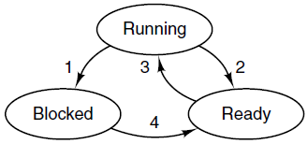
Process States (2 of 3)
Process blocks for input
Scheduler picks another process
Scheduler picks this process
Input becomes available
Figure 2-2. A process can be in running, blocked, or ready state. Transitions between these states are as shown.

Slide 9
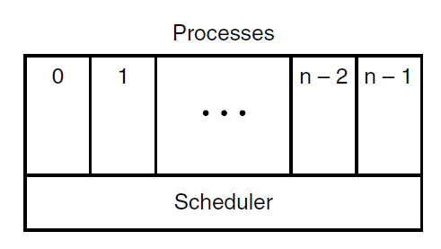
Process States (3 of 3)
Figure 2-3. The lowest layer of a process-structured operating system handles interrupts and scheduling. Above that layer are sequential processes.

Slide 10
Implementation of Processes (1 of 2)
Some of the fields of a typical process table entry.
Process management Registers Program counter Program status word Stack pointer Process state Priority Scheduling parameters Process I D Parent process Process group Signals Time when process started C P U time used Children's C P U time Time of next alarm | Memory management Pointer to text segment info Pointer to data segment info Pointer to stack segment info | File management Root directory Working directory File descriptors User I D Group I D

Slide 11
Implementation of Processes (2 of 2)
Skeleton of what the lowest level of the operating system does when an interrupt occurs.
Hardware stacks program counter, etc.
Hardware loads new program counter from interrupt vector.
Assembly language procedure saves registers.
Assembly language procedure sets up new stack.
C interrupt service runs (typically reads and buffers input).
Scheduler decides which process is to run next.
C procedure returns to the assembly code.
Assembly language procedure starts up new current process.

Slide 12
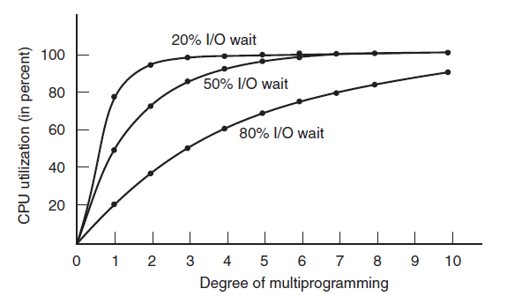
Modeling Multiprogramming
Figure 2-6. C P U utilization as a function of the number of processes in memory.

Slide 13
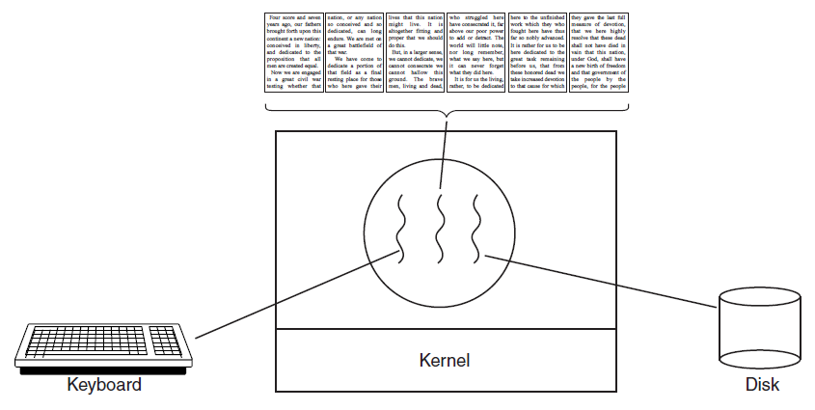
Thread Usage (1 of 4)
Figure 2-7. A word processor with three threads.

Slide 14
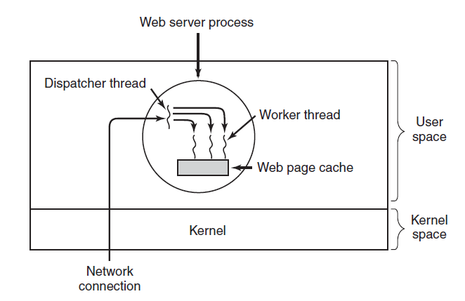
Thread Usage (2 of 4)
Figure 2-8. A multithreaded Web server.

Slide 15
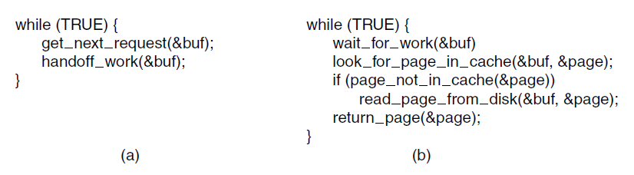
Thread Usage (3 of 4)
Figure 2-9. A rough outline of the code for Fig. 2-8. (a) Dispatcher thread. (b) Worker thread.

Slide 16
Thread Usage (4 of 4)
Three ways to construct a server.
Model | Characteristics
Threads | Parallelism, blocking system calls
Single-threaded process | No parallelism, blocking system calls
Finite-state machine | Parallelism, nonblocking system calls, interrupts

Slide 17
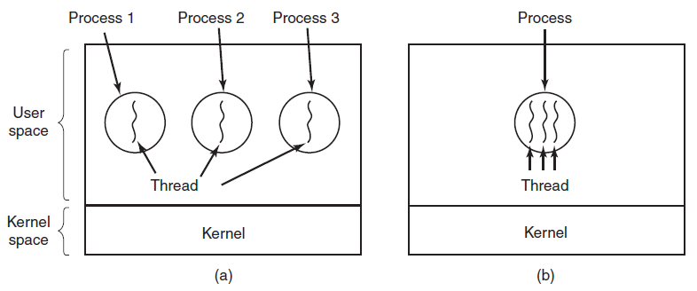
The Classical Thread Model (1 of 3)
Figure 2-11. (a) Three processes each with one thread. (b) One process with three threads.

Slide 18
The Classical Thread Model (2 of 3)
The first column lists some items shared by all threads in a process. The second one lists some items private to each thread.
Per process items Address space Global variables Open files Child processes Pending alarms Signals and signal handlers Accounting information | Per thread items Program counter Registers Stack State

Slide 19
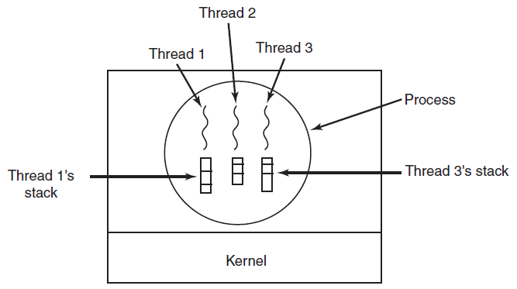
The Classical Thread Model (3 of 3)
Figure 2-13. Each thread has its own stack.

Slide 20
P O S I X Threads (1 of 3)
Some of the Pthreads function calls.
Thread call | Description
Pthread_create | Create a new thread
Pthread—exit | Terminate the calling thread
Pthread_join | Wait for a specific thread to exit
Pthread_yield | Release the CPU to let another thread run
Pthread_attr—init | Create and initialize a thread's attribute structure
Pthread_attr_destroy | Remove a thread's attribute structure

Slide 21
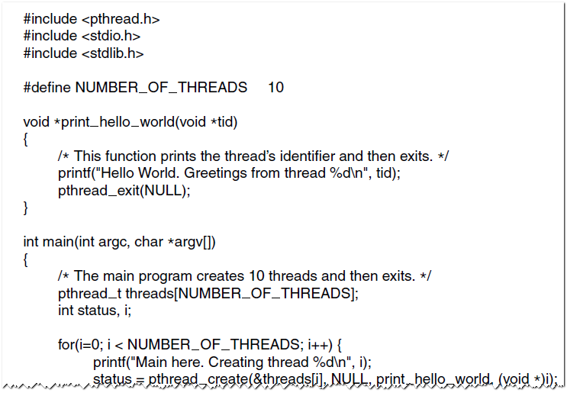
P O S I X Threads (2 of 3)
Figure 2-15. An example program using threads.

Slide 22
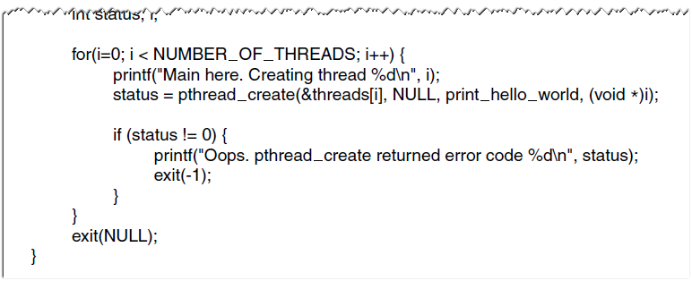
P O S I X Threads (3 of 3)
Figure 2-15. An example program using threads.

Slide 23
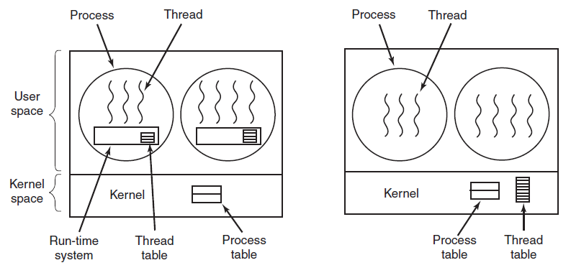
Implementing Threads in User Space
Figure 2-16. (a) A user-level threads package. (b) A threads package managed by the kernel.

Slide 24
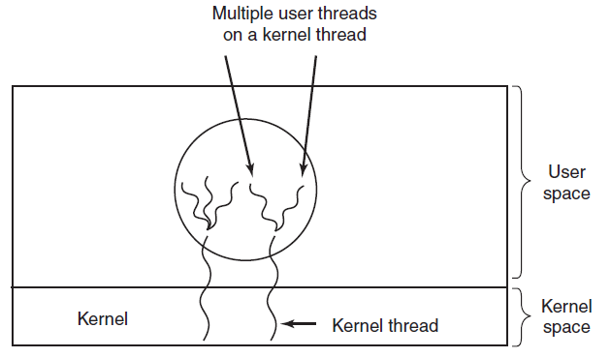
Hybrid Implementations
Figure 2-17. Multiplexing user-level threads onto kernel-level threads.

Slide 25
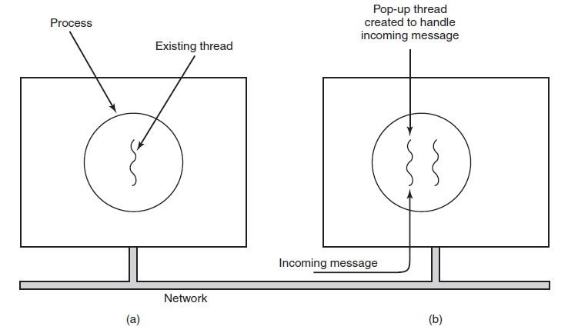
Pop-Up Threads
Figure 2-18. Creation of a new thread when a message arrives. (a) Before the message arrives. (b) After the message arrives.

Slide 26
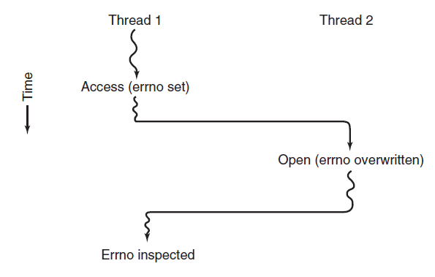
Making Single-Threaded Code Multithreaded (1 of 2)
Figure 2-19. Conflicts between threads over the use of a global variable.

Slide 27
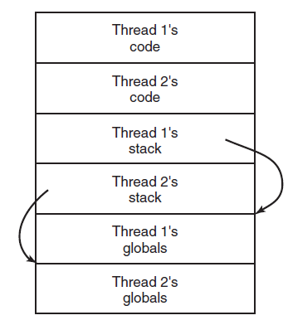
Making Single-Threaded Code Multithreaded (2 of 2)
Figure 2-20. Threads can have private global variables.

Slide 28
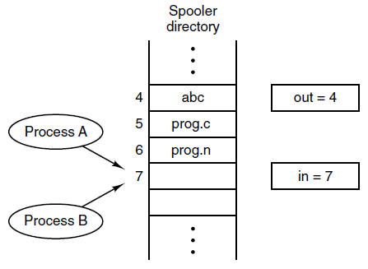
Race Conditions
Figure 2-21. Two processes want to access shared memory at the same time.

Slide 29
Critical Regions (1 of 2)
Requirements to avoid race conditions:
No two processes may be simultaneously inside their critical regions.
No assumptions may be made about speeds or the number of CPUs.
No process running outside its critical region may block other processes.
No process should have to wait forever to enter its critical region.

Slide 30
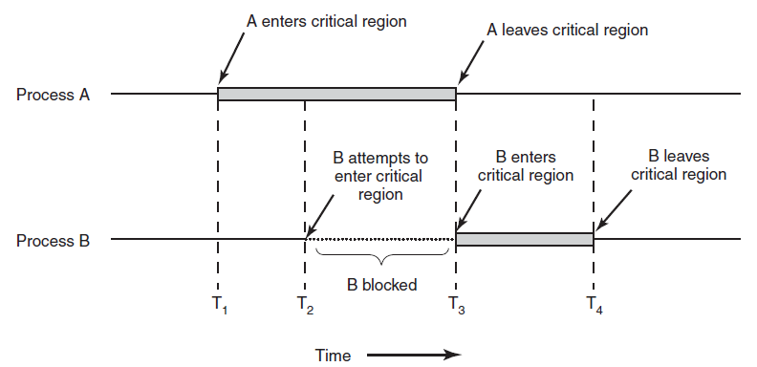
Critical Regions (2 of 2)
Figure 2-22. Mutual exclusion using critical regions.

Slide 31
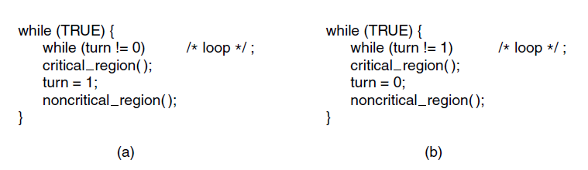
Mutual Exclusion with Busy Waiting: Strict Alternation
Figure 2-23. A proposed solution to the critical region problem. (a) Process 0. (b) Process 1. In both cases, be sure to note the semicolons terminating the while statements.

Slide 32
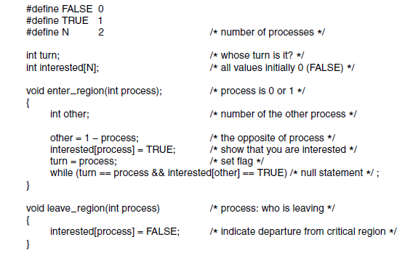
Mutual Exclusion with Busy Waiting: Peterson’s Solution
Figure 2-24. Peterson’s solution for achieving mutual exclusion.

Slide 33
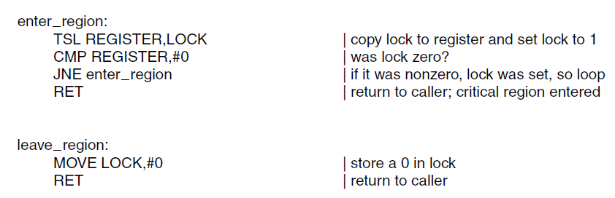
Mutual Exclusion with Busy Waiting: The TSL Instruction (1 of 2)
Figure 2-25. Entering and leaving a critical region using the T S L instruction.

Slide 34
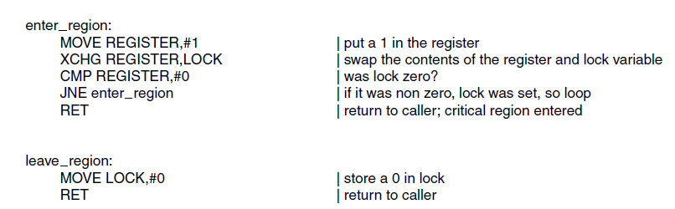
Mutual Exclusion with Busy Waiting: The TSL Instruction (2 of 2)
Figure 2-26. Entering and leaving a critical region using the XCHG instruction

Slide 35
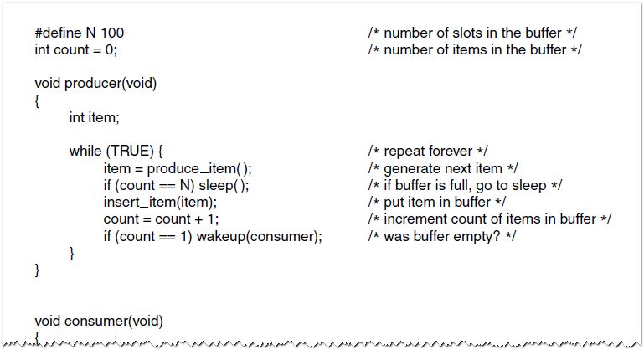
Sleep and Wakeup: The Producer-Consumer Problem (1 of 2)
Figure 2-27. The producer-consumer problem with a fatal race condition.

Slide 36
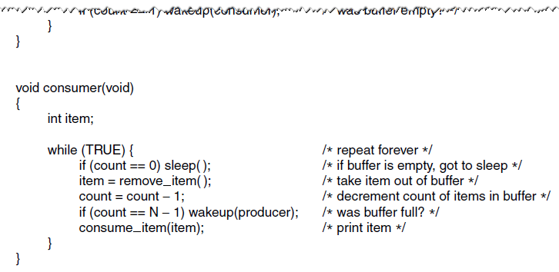
Sleep and Wakeup: The Producer-Consumer Problem (2 of 2)
Figure 2-27. The producer-consumer problem with a fatal race condition.

Slide 37
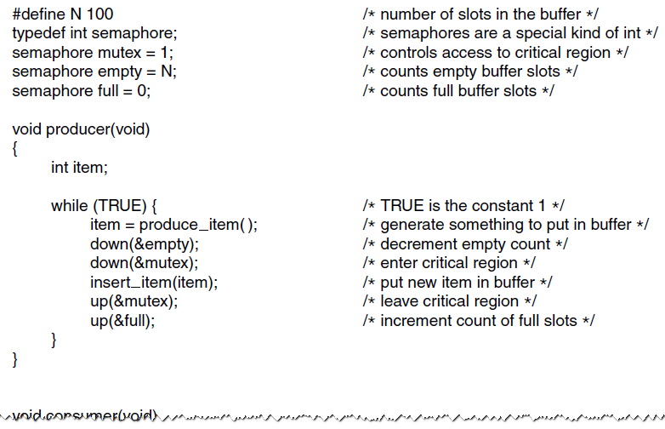
Semaphores (1 of 2)
Figure 2-28. The producer-consumer problem using semaphores.

Slide 38
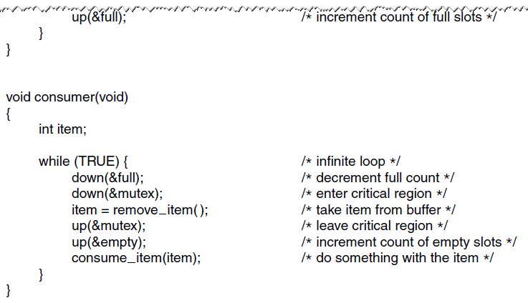
Semaphores (2 of 2)
Figure 2-28. The producer-consumer problem using semaphores.

Slide 39
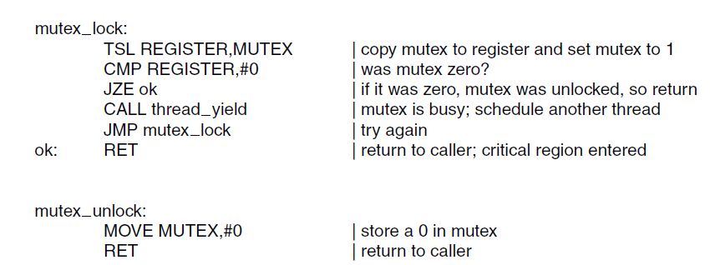
Mutexes
Figure 2-29. Implementation of mutex_lock and mutex_unlock.

Slide 40
Mutexes in Pthreads (1 of 5)
Some of the Pthreads calls relating to mutexes.
Thread Call | Description
Pthread_mutex | Create a mutex
Pthread_mutex | Destroy an existing mutex
Pthread _mutex | Acquire a lock or block
Pthread_mutex | Acquire a lock or fail
Pthread_mutex | Release a lock

Slide 41
Mutexes in Pthreads (2 of 5)
Some of the Pthreads calls relating to condition variables.
Thread Call | Description
Pthread_cond_init | Create a mutex
Pthread_cond_destroy | Destroy an existing mutex
Pthread _cond_wait | Acquire a lock or block
Pthread_cond_signal | Acquire a lock or fail
Pthread_cond_broadcast | Release a lock

Slide 42
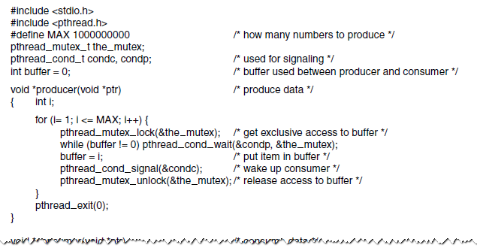
Mutexes in Pthreads (3 of 5)
Figure 2-32. Using threads to solve the producer-consumer problem.

Slide 43
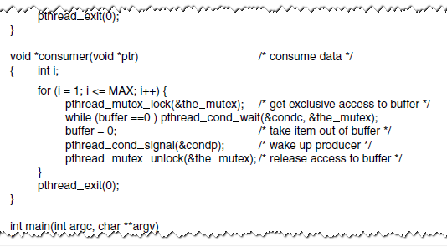
Mutexes in Pthreads (4 of 5)
Figure 2-32. Using threads to solve the producer-consumer problem.

Slide 44
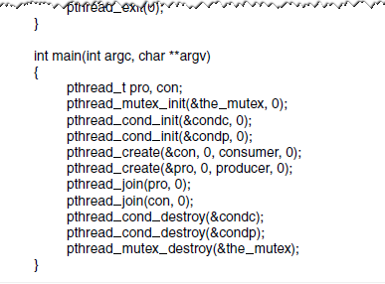
Mutexes in Pthreads (5 of 5)
Figure 2-32. Using threads to solve the producer-consumer problem.

Slide 45
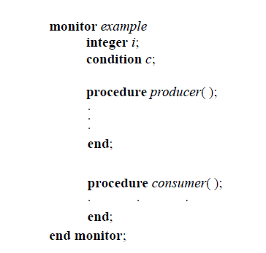
Monitors (1 of 6)
Figure 2-33. A monitor.

Slide 46
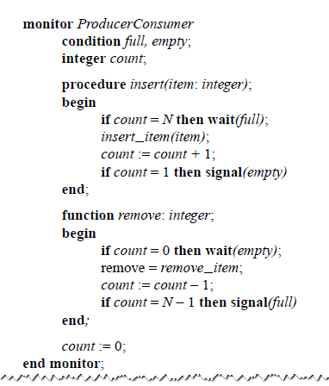
Monitors (2 of 6)
Figure 2-34. An outline of the producer-consumer problem with monitors. Only one monitor procedure at a time is active. The buffer has N slots.

Slide 47
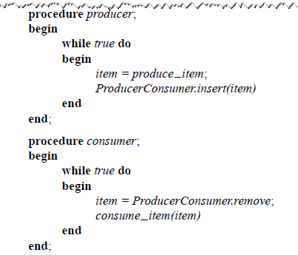
Monitors (3 of 6)
Figure 2-34. An outline of the producer-consumer problem with monitors. Only one monitor procedure at a time is active. The buffer has N slots.

Slide 48
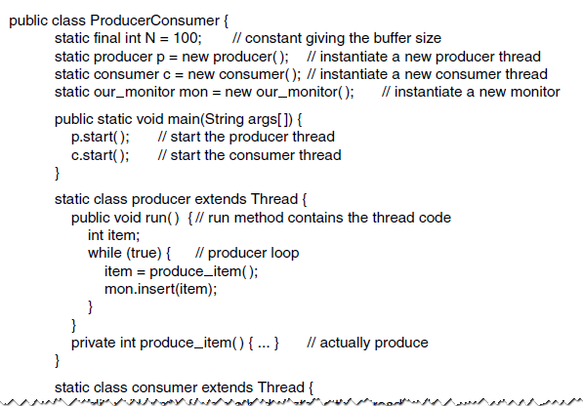
Monitors (4 of 6)
Figure 2-35. A solution to the producer-consumer problem in Java.

Slide 49
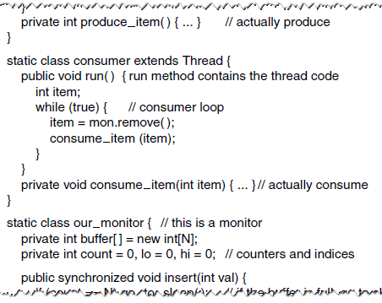
Monitors (5 of 6)
Figure 2-35. A solution to the producer-consumer problem in Java.

Slide 50
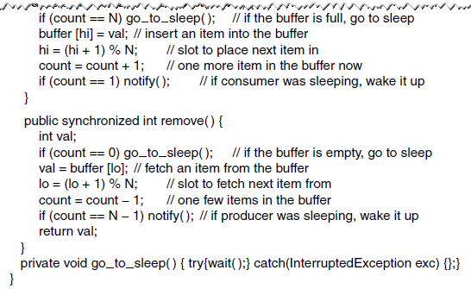
Monitors (6 of 6)
Figure 2-35. A solution to the producer-consumer problem in Java.

Slide 51
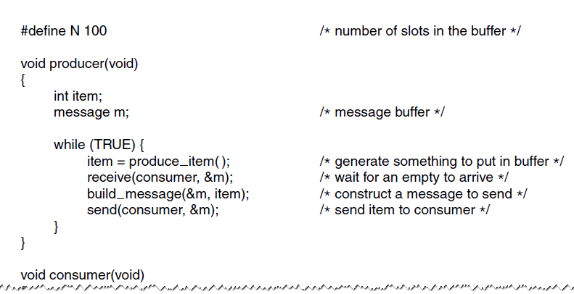
The Producer-Consumer Problem with Message Passing (1 of 2)
Figure 2-36. The producer-consumer problem with N messages.

Slide 52
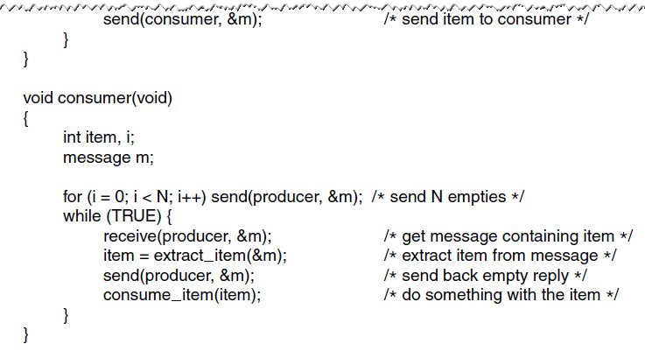
The Producer-Consumer Problem with Message Passing (2 of 2)
Figure 2-36. The producer-consumer problem with N messages.

Slide 53
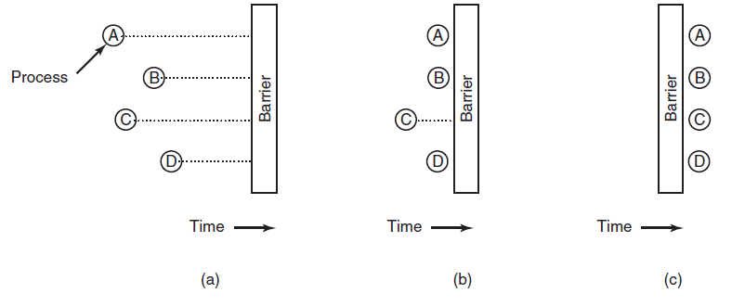
Barriers
Figure 2-37. Use of a barrier. (a) Processes approaching a barrier. (b) All processes but one blocked at the barrier. (c) When the last process arrives at the barrier, all of them are let through.

Slide 54
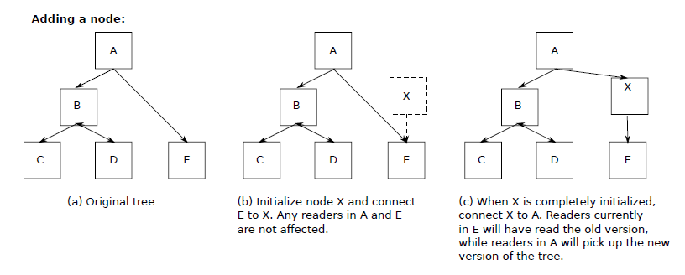
Avoiding Locks: Read-Copy-Update (1 of 2)
Figure 2-38. Read-Copy-Update: inserting a node in the tree and then removing a branch-all without locks

Slide 55
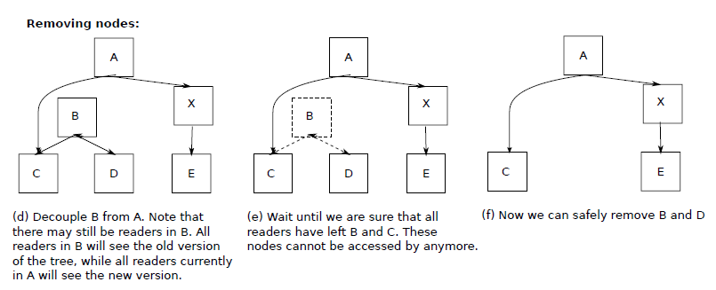
Avoiding Locks: Read-Copy-Update (2 of 2)
Figure 2-38. Read-Copy-Update: inserting a node in the tree and then removing a branch-all without locks

Slide 56
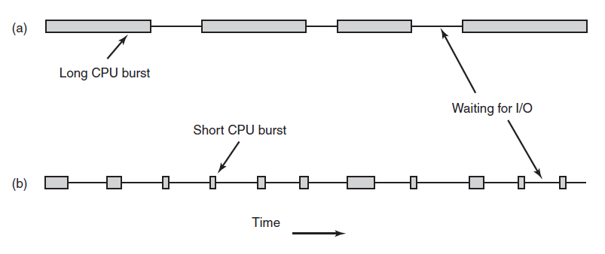
Introduction to Scheduling Process Behavior
Figure 2-39. Bursts of C P U usage alternate with periods of waiting for I/O. (a) A C P U-bound process. (b) An I/O-bound process.

Slide 57
Categories of Scheduling Algorithms
Batch.
Interactive.
Real time.

Slide 58
Scheduling Algorithm Goals (1 of 2)
Some goals of the scheduling algorithm under different circumstances.
All systems
Fairness - giving each process a fair share of the C P U
Policy enforcement - seeing that stated policy is carried out
Balance - keeping all parts of the system busy
Batch systems
Throughput - maximize jobs per hour

Slide 59
Scheduling Algorithm Goals (2 of 2)
Turnaround time - minimize time between submission and termination
C P U utilization - keep the C P U busy all the time
Interactive systems
Response time - respond to requests quickly
Proportionality - meet users' expectations
Real-time systems
Meeting deadlines - avoid losing data
Predictability - avoid quality degradation in multimedia systems

Slide 60
Scheduling in Batch Systems
First-Come First-Served
Shortest Job First
Shortest Remaining Time Next

Slide 61
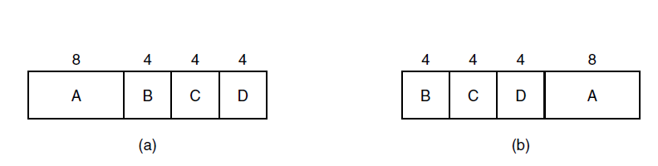
Shortest Job First
Figure 2-41. An example of shortest job first scheduling. (a) Running four jobs in the original order. (b) Running them in shortest job first order.

Slide 62
Scheduling in Interactive Systems
Round-Robin Scheduling
Priority Scheduling
Multiple Queues
Shortest Process Next
Guaranteed Scheduling
Lottery Scheduling
Fair-Share Scheduling

Slide 63
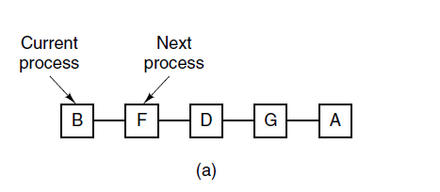
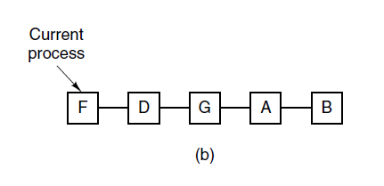
Round-Robin Scheduling
Figure 2-42. Round-robin scheduling. (a) The list of runnable processes. (b) The list of runnable processes after B uses up its quantum.

Slide 64
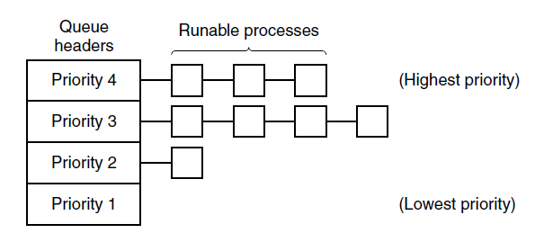
Priority Scheduling
Figure 2-43. A scheduling algorithm with four priority classes.

Slide 65
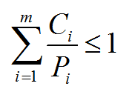
Scheduling in Real-Time Systems
Time plays an essential role
Categories
Hard real time
Soft real time
Periodic or aperiodic
Schedulable satisfies

Slide 66

Thread Scheduling (1 of 2)
Figure 2-44. (a) Possible scheduling of user-level threads with a 50-msec process quantum and threads that run 5 msec per C P U burst.

Slide 67

Thread Scheduling (2 of 2)
Figure 2-44. (b) Possible scheduling of kernel-level threads with the same characteristics as (a).

Slide 68

The Dining Philosophers Problem (1 of 5)
Figure 2-45. Lunch time in the Philosophy Department.

Slide 69

The Dining Philosophers Problem (2 of 5)
Figure 2-46. A nonsolution to the dining philosophers problem.

Slide 70

The Dining Philosophers Problem (3 of 5)
Figure 2-47. A solution to the dining philosophers problem.

Slide 71

The Dining Philosophers Problem (4 of 5)
Figure 2-47. A solution to the dining philosophers problem.

Slide 72

The Dining Philosophers Problem (5 of 5)
Figure 2-47. A solution to the dining philosophers problem.

Slide 73

The Readers and Writers Problem (1 of 2)
Figure 2-48. A solution to the readers and writers problem.

Slide 74

The Readers and Writers Problem (2 of 2)
Figure 2-48. A solution to the readers and writers problem.

Slide 75

Copyright

